Slide 1
XOR
Multi-Layer Perceptron

Slide 2
Class Lab – 기초 과제 일정
XOR(~4/05)
MNIST(~4/19)
3. CIFAR10(~5/03)

Slide 3
How to Learn
Draw a line between circles and triangles!

Slide 4
How to Learn
Draw a line between circles and triangles!
Correct!

Slide 5
How to Learn
Draw a line between circles and triangles!
Wrong!

Slide 6
How to Learn
Draw a line between circles and triangles!
Wrong but better than the previous one

Slide 7
How to Learn
Draw a line between circles and triangles!
Correct!

Slide 8
How to Learn
Make a line
Find what is wrong
Modify it

Slide 9
Neural Network
Evaluation (forward propagation)
Loss and Gradient (Backpropagation)
Update (SGD)

Slide 10
Neural Network
Evaluation (forward propagation)
Loss and Gradient (Backpropagation)
Update (SGD)

Slide 11
Perceptron
Transform
Input
Output

Slide 12
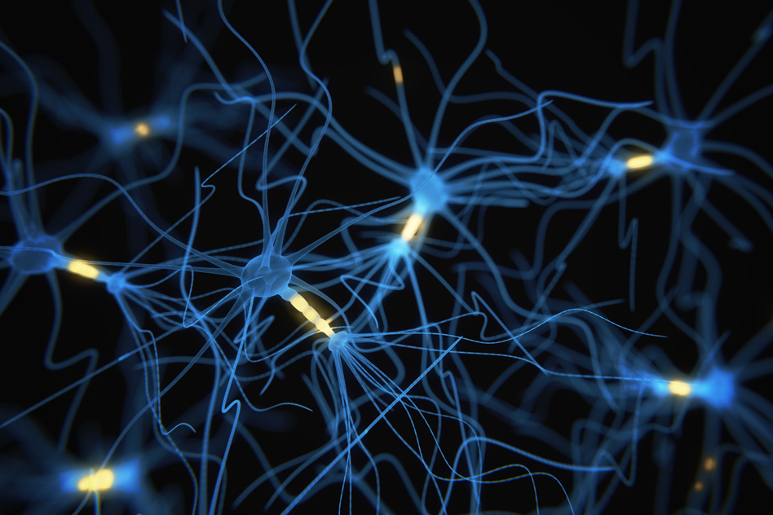
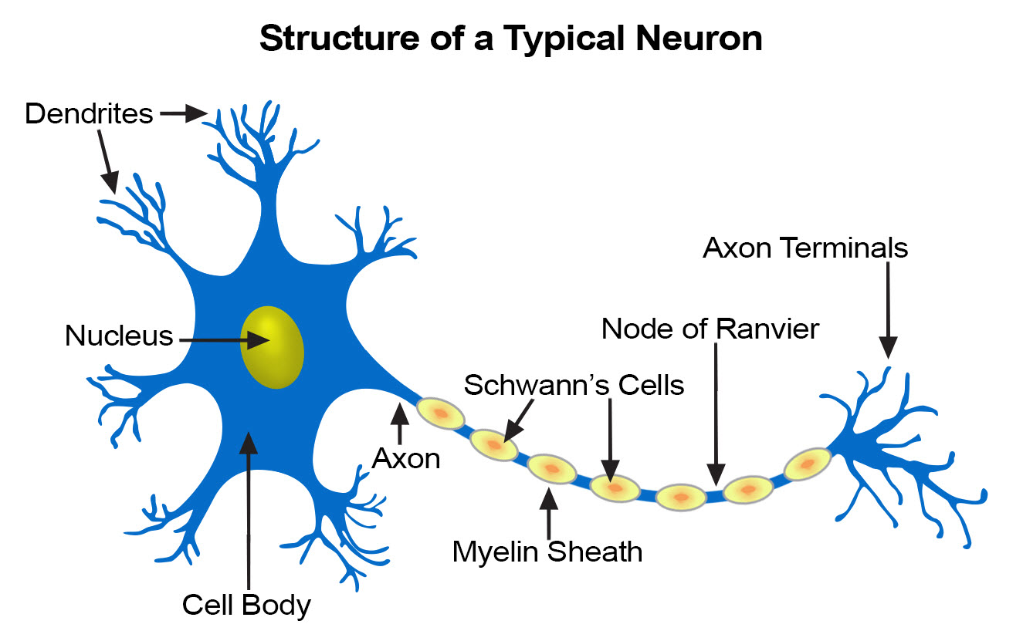
Perceptron

Slide 13
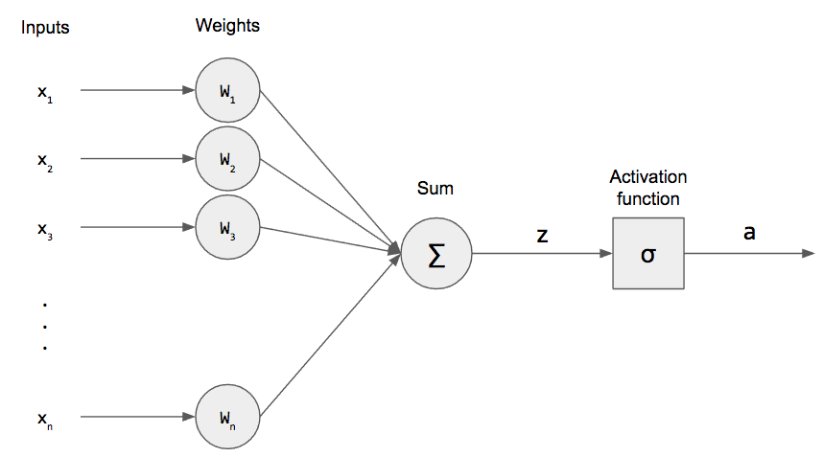
Perceptron
Weighted Sum + Nonlinear Function

Slide 14
Perceptron
$$z=w_{1}x_{1}+w_{2}x_{2}+…+w_{n}x_{n}+b$$

Slide 15
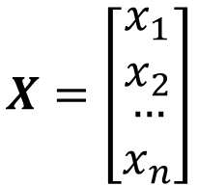


Perceptron
$$z=w_{1}x_{1}+w_{2}x_{2}+…+w_{n}x_{n}+b$$
$$z=WX+b$$
$$X=\left[\begin{matrix}\begin{matrix}x_{1} \\ x_{2}\end{matrix} \\ \begin{matrix}… \\ x_{n}\end{matrix}\end{matrix}\right]$$
$$W=\left[\begin{matrix}\begin{matrix}w_{1} & w_{2}\end{matrix} & \begin{matrix}… & w_{n}\end{matrix}\end{matrix}\right]$$
Matrix Multiplication

Slide 16
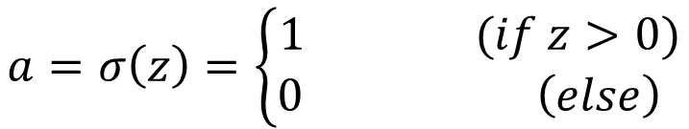
Perceptron
$$z=w_{1}x_{1}+w_{2}x_{2}+…+w_{n}x_{n}+b$$
$$z=WX+b$$
$$a=σ\left(z\right)=\left\{\begin{aligned}1 (if z>0) \\ 0 \left(else\right) \end{aligned}\right.$$

Slide 17

Perceptron
Perceptron can deal with linearly separable problems
$$z=WX+w_{0}$$

Slide 18
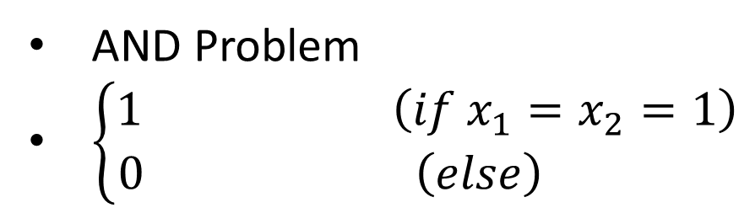
Perceptron
Perceptron can deal with linearly separable problems
AND Problem
$\left\{\begin{aligned}1 \left(if x_{1}=x_{2}=1\right) \\ 0 \left(else\right) \end{aligned}\right.$

Slide 19










Perceptron
Perceptron can deal with linearly separable problems
AND Problem
$z=x_{1}+x_{2}−1.5$
$$W=\left[\begin{matrix}1 & 1\end{matrix}\right]$$
$$X=\left[\begin{aligned}x_{1} \\ x_{2}\end{aligned}\right]$$
$$b=−1.5$$
$$x_{1}$$
$$1$$
$Σ$
$$z$$
$$x_{2}$$
$$1$$

Slide 20
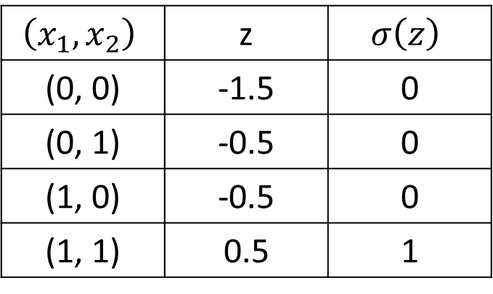

Perceptron
Perceptron can deal with linearly separable problems
AND Problem
$z=x_{1}+x_{2}−1.5$
$$\left(x_{1},x_{2}\right)$$ | z | $$σ\left(z\right)$$
(0, 0) | -1.5 | 0
(0, 1) | -0.5 | 0
(1, 0) | -0.5 | 0
(1, 1) | 0.5 | 1

Slide 21
Multi-Layer Perceptron
XOR Problem
Draw a line between circles and triangles!

Slide 22
Multi-Layer Perceptron
XOR Problem
Draw two lines between circles and triangles!

Slide 23
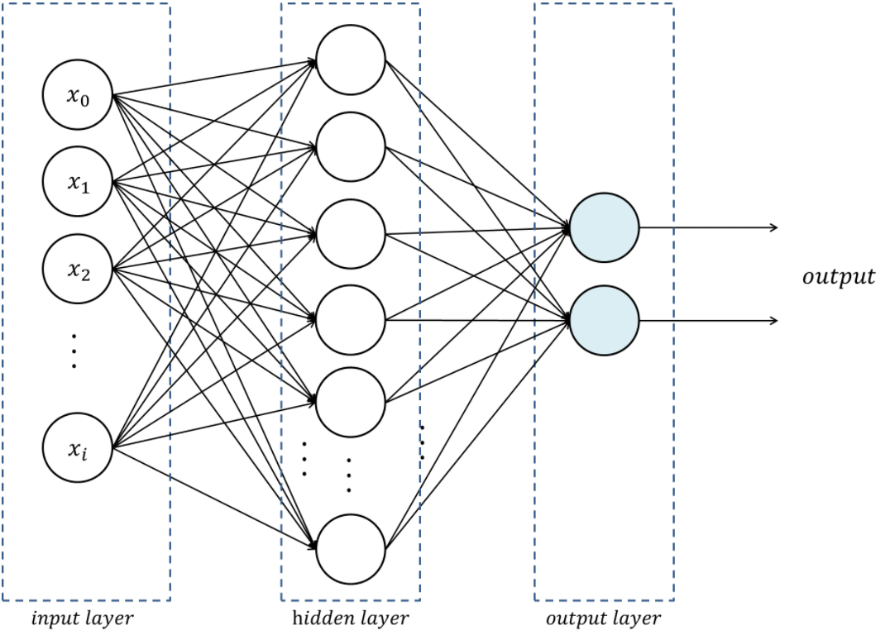
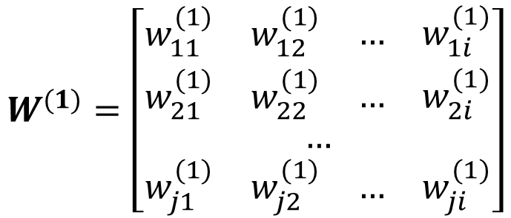
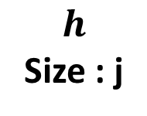
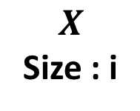
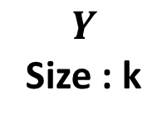

Multi-Layer Perceptron
Stack of perceptron
$$h=σ\left(W^{(1)}X+b^{(1)}\right)$$
$$W^{(1)}=\left[\begin{aligned}\begin{matrix}\begin{matrix}w_{11}^{(1)} & w_{12}^{(1)}\end{matrix} & \begin{matrix}… & w_{1i}^{(1)}\end{matrix}\end{matrix} \\ \begin{matrix}\begin{matrix}w_{21}^{(1)} & w_{22}^{(1)}\end{matrix} & \begin{matrix}… & w_{2i}^{(1)}\end{matrix}\end{matrix} \\ … \\ \begin{matrix}\begin{matrix}w_{j1}^{(1)} & w_{j2}^{(1)}\end{matrix} & \begin{matrix}… & w_{ji}^{(1)}\end{matrix}\end{matrix}\end{aligned}\right]$$
$$X$$
Size : i
$$h$$
Size : j
$$Y$$
Size : k
( j x i ) matrix

Slide 24

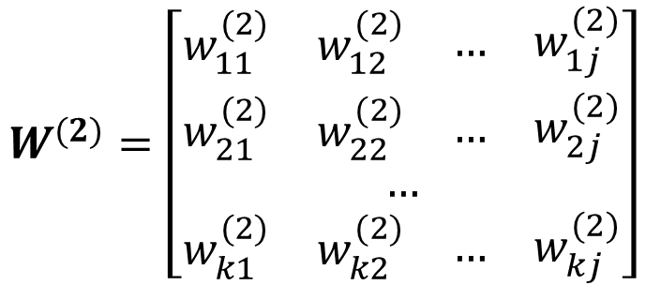
Multi-Layer Perceptron
Stack of perceptron
$$h=σ\left(W^{(1)}X+b^{(1)}\right)$$
$$Y=σ\left(W^{(2)}h+b^{(2)}\right)$$
$$W^{(2)}=\left[\begin{aligned}\begin{matrix}\begin{matrix}w_{11}^{(2)} & w_{12}^{(2)}\end{matrix} & \begin{matrix}… & w_{1j}^{(2)}\end{matrix}\end{matrix} \\ \begin{matrix}\begin{matrix}w_{21}^{(2)} & w_{22}^{(2)}\end{matrix} & \begin{matrix}… & w_{2j}^{(2)}\end{matrix}\end{matrix} \\ … \\ \begin{matrix}\begin{matrix}w_{k1}^{(2)} & w_{k2}^{(2)}\end{matrix} & \begin{matrix}… & w_{kj}^{(2)}\end{matrix}\end{matrix}\end{aligned}\right]$$
$$X$$
Size : i
$$h$$
Size : j
$$Y$$
Size : k
( k x j ) matrix

Slide 25
Multi-Layer Perceptron
XOR Problem

Slide 26
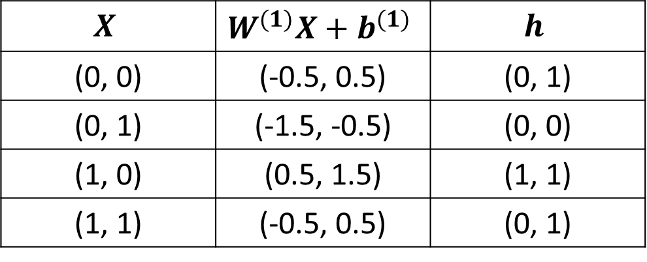
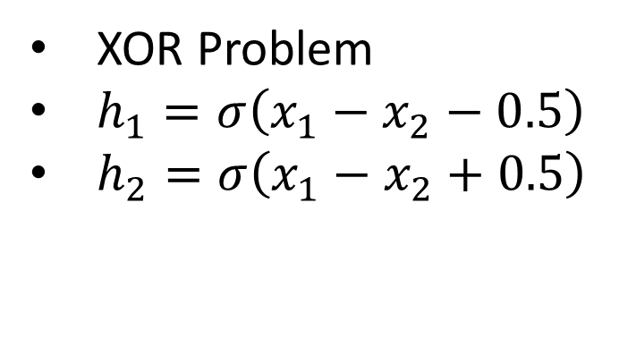
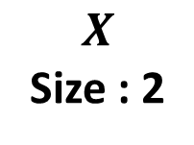
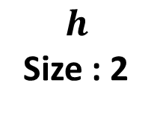
Multi-Layer Perceptron
XOR Problem
$h_{1}=σ\left(x_{1}−x_{2}−0.5\right)$
$h_{2}=σ\left(x_{1}−x_{2}+0.5\right)$
$$X$$ | $$W^{(1)}X+b^{(1)}$$ | $$h$$
(0, 0) | (-0.5, 0.5) | (0, 1)
(0, 1) | (-1.5, -0.5) | (0, 0)
(1, 0) | (0.5, 1.5) | (1, 1)
(1, 1) | (-0.5, 0.5) | (0, 1)
$$X$$
Size : 2
$$h$$
Size : 2

Slide 27
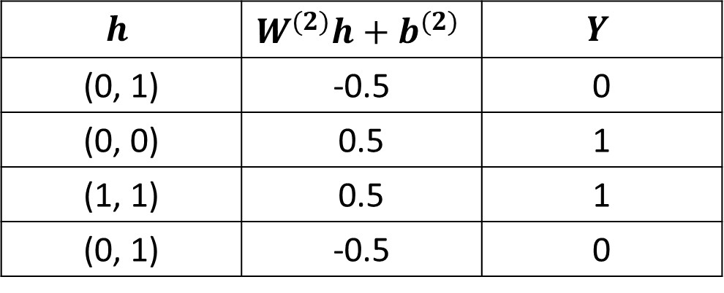
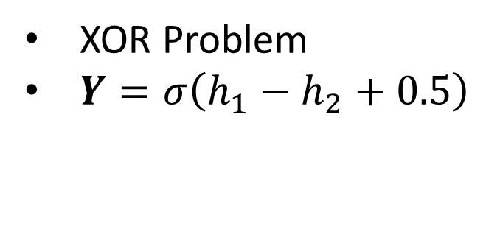
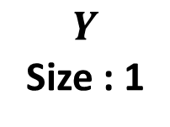
Multi-Layer Perceptron
XOR Problem
$Y=σ\left(h_{1}−h_{2}+0.5\right)$
$$h$$ | $$W^{(2)}h+b^{(2)}$$ | $$Y$$
(0, 1) | -0.5 | 0
(0, 0) | 0.5 | 1
(1, 1) | 0.5 | 1
(0, 1) | -0.5 | 0
$$X$$
Size : 2
$$h$$
Size : 2
$$Y$$
Size : 1

Slide 28
Multi-Layer Perceptron
2-layer Perceptron can deal with some nonlinear problems

Slide 29
Multi-Layer Perceptron
n-layer Perceptron can deal with more complex problems

Slide 30
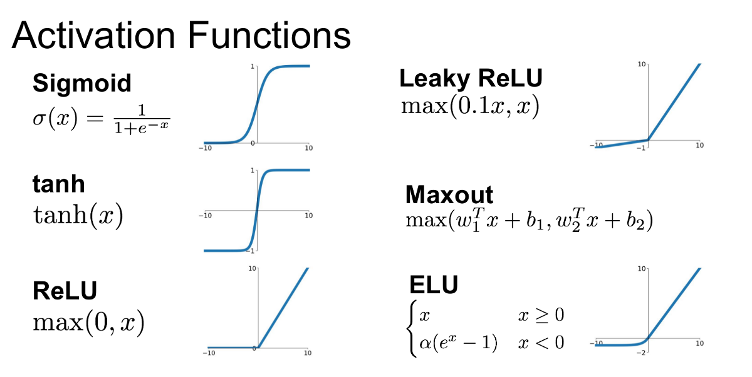
Multi-Layer Perceptron
Activation function is needed for nonlinearity

Slide 31

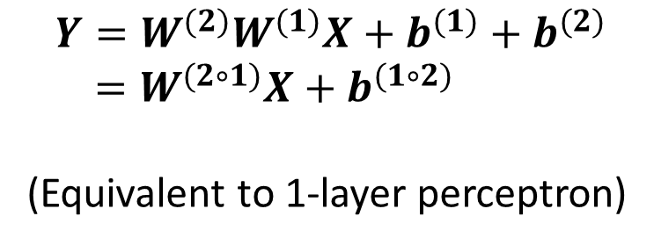



Multi-Layer Perceptron
Activation function is needed for nonlinearity
With activation
Without activation
$$h=σ\left(W^{(1)}X+b^{(1)}\right)$$
$$h=W^{(1)}X+b^{(1)}$$
$$Y=σ\left(W^{(2)}h+b^{(2)}\right)$$
$$Y=W^{(2)}h+b^{(2)}$$
$$Y=σ\left(W^{(2)}σ\left(W^{(1)}X+b^{(1)}\right)+b^{(2)}\right)$$
$$Y=W^{(2)}W^{(1)}X+b^{(1)}+b^{(2)}$$
$=W^{(2∘1)}X+b^{(1∘2)}$
(Equivalent to 1-layer perceptron)

Slide 32
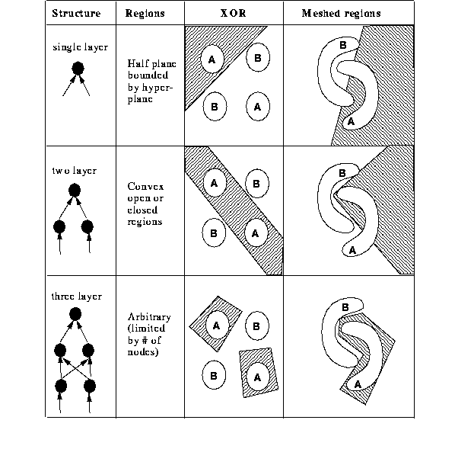
Multi-Layer Perceptron
Deeper networks can represent more complex topology
Deeper = Better ?

Slide 33
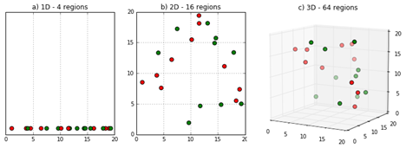
Multi-Layer Perceptron
Curse of Dimensionality
Hard to optimize
Prone to overfit

Slide 34
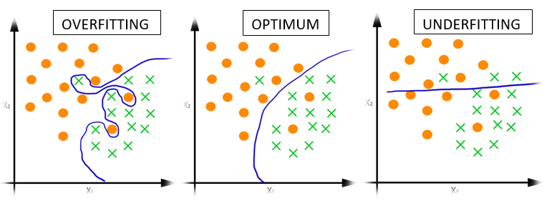
Multi-Layer Perceptron
Overfit

Slide 35
Neural Network
Evaluation (forward propagation)
Loss and Gradient (Backpropagation)
Update (SGD)

Slide 36
Backpropagation

Slide 37
Backpropagation
4 incorrect examples
2 incorrect examples

Slide 38
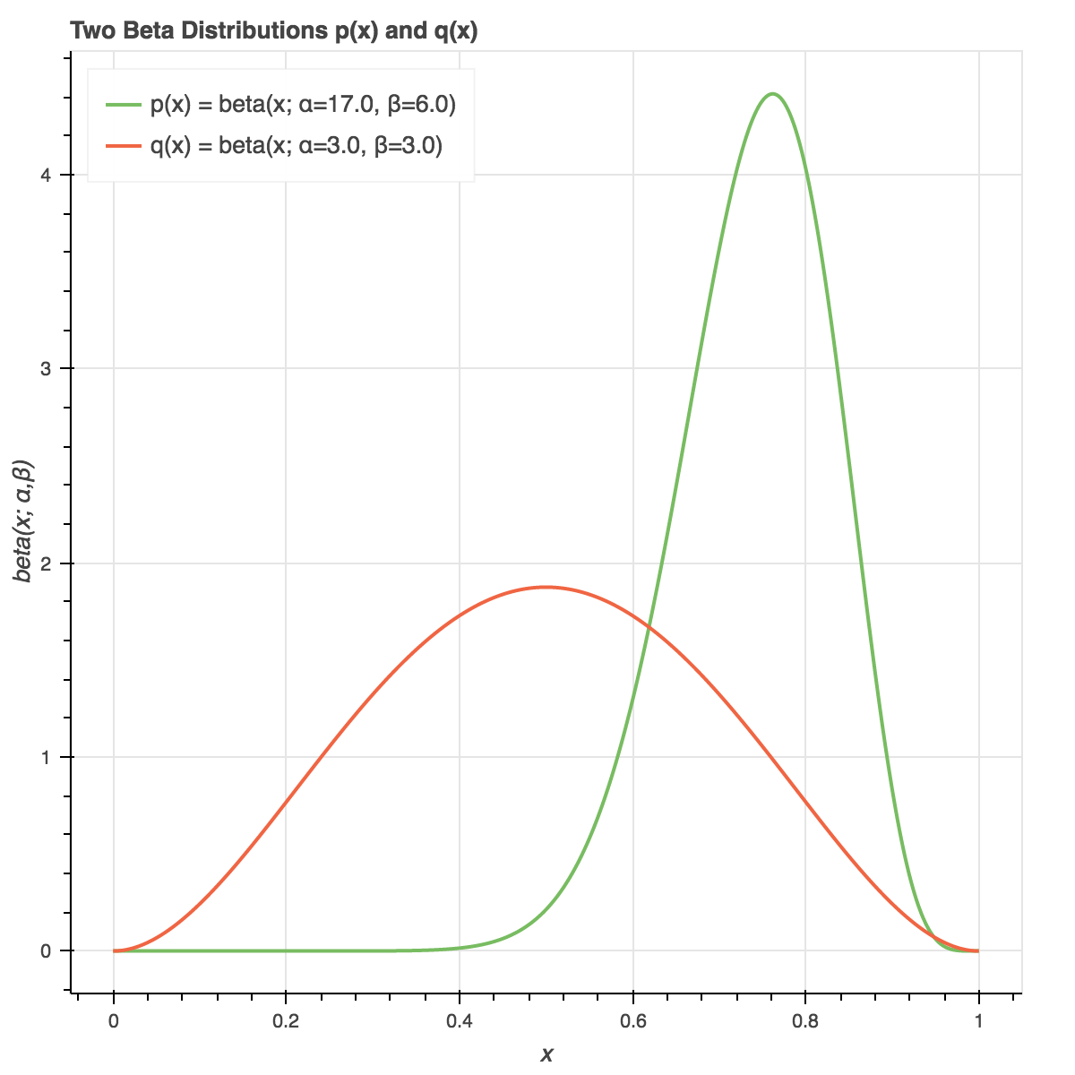
Backpropagation
Loss(=cost) : A real number that represents how much wrong it is
Prediction: 3.4
Answer: 3.7
Loss : 4
Loss : 0.09
Loss : 1.7

Slide 39
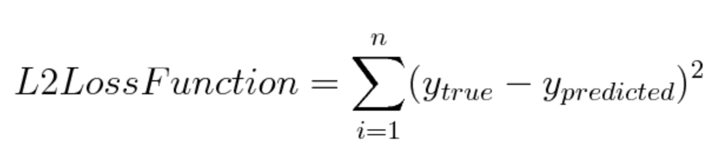
Backpropagation
L2-loss
Prediction: 3.4
Answer: 3.7
Measure distance between real values
Loss : 0.09

Slide 40

Backpropagation
Cross Entropy
Measure distance between two probability distribution
Mostly used in classification problems
Loss : 1.7

Slide 41
Backpropagation
We should minimize the loss
How?

Slide 42
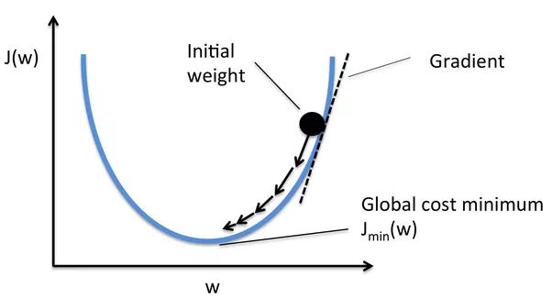
Backpropagation
We should minimize the loss using differentiation
Parameter : W
Loss function : J(W)

Slide 43
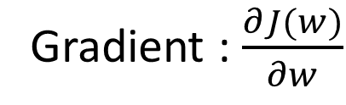
Backpropagation
We should minimize the loss using differentiation
Gradient : $\frac{∂J(w)}{∂w}$

Slide 44





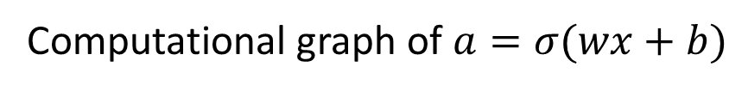




Backpropagation
Backpropagation: Using chain rule, calculate gradient step- by-step
$x$
$×$
$$y$$
$$w$$
$+$
$$z$$
$σ$
$a$
$$b$$
Computational graph of $a=σ(wx+b)$

Slide 45


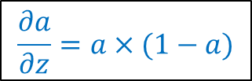











Backpropagation
Backpropagation: Using chain rule, calculate gradient step- by-step
$$\frac{∂J}{∂x}=\frac{∂J}{∂y}\frac{∂y}{∂x}$$
$$\frac{∂J}{∂y}=\frac{∂J}{∂z}\frac{∂z}{∂y}$$
$0.9$
$$a=\frac{1}{1+e^{−Z}}$$
$×$
$0.63$
$0.7$
$+$
$0.83$
$σ$
$0.70$
$$\frac{∂J}{∂w}=\frac{∂J}{∂y}\frac{∂y}{∂w}$$
$0.2$
$$\frac{∂J}{∂z}=\frac{∂J}{∂a}\frac{∂a}{∂z}$$
$$\frac{∂a}{∂z}=a×(1−a)$$
$$\frac{∂J}{∂a}=0.5$$
$$\frac{∂J}{∂b}=\frac{∂J}{∂z}\frac{∂z}{∂b}$$

Slide 46



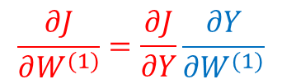


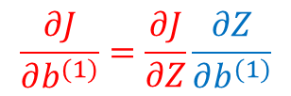

Backpropagation
Backpropagation: Using chain rule, calculate gradient step- by-step
$$\frac{∂J}{∂X}=\frac{∂J}{∂Y}\frac{∂Y}{∂X}$$
$$\frac{∂J}{∂Y}=\frac{∂J}{∂Z}\frac{∂Z}{∂Y}$$
$0.9$
$×$
$0.63$
$$Z=Y+b^{(1)}$$
$0.7$
$+$
$0.83$
$σ$
$0.70$
$$\frac{∂J}{∂W^{(1)}}=\frac{∂J}{∂Y}\frac{∂Y}{∂W^{(1)}}$$
$0.2$
$$\frac{∂J}{∂a}=0.5$$
$$\frac{∂Z}{∂Y}=1$$
$$\frac{∂Z}{∂b^{(1)}}=1$$
$$\frac{∂J}{∂Z}=0.105$$
$$\frac{∂J}{∂b^{(1)}}=\frac{∂J}{∂Z}\frac{∂Z}{∂b^{(1)}}$$

Slide 47




Backpropagation
Backpropagation: Using chain rule, calculate gradient step- by-step
$$\frac{∂J}{∂X}=\frac{∂J}{∂Y}\frac{∂Y}{∂X}$$
$$\frac{∂J}{∂Y}=0.105$$
$0.9$
$$Y=W^{(1)}X$$
$×$
$0.63$
$0.7$
$$\frac{∂Y}{∂X}=W^{(1)}$$
$$\frac{∂Z}{∂W^{(1)}}=X$$
$+$
$0.83$
$σ$
$0.70$
$$\frac{∂J}{∂W^{(1)}}=\frac{∂J}{∂Y}\frac{∂Y}{∂W^{(1)}}$$
$0.2$
$$\frac{∂J}{∂a}=0.5$$
$$\frac{∂J}{∂Z}=0.105$$
$$\frac{∂J}{∂b^{(1)}}=0.105$$

Slide 48


Backpropagation
Backpropagation: Using chain rule, calculate gradient step- by-step
$$\frac{∂J}{∂X}=0.0735$$
$$\frac{∂J}{∂Y}=0.105$$
$0.9$
$×$
$0.63$
$0.7$
$+$
$0.83$
$σ$
$0.70$
$$\frac{∂J}{∂W^{(1)}}=0.0945$$
$0.2$
$$\frac{∂J}{∂a}=0.5$$
$$\frac{∂J}{∂Z}=0.105$$
$$\frac{∂J}{∂b^{(1)}}=0.105$$

Slide 49


Backpropagation
Backpropagation: Using chain rule, calculate gradient step- by-step
$$J=−log⁡(σ\left(w_{1}x_{1}+w_{2}x_{2}+w_{3}x_{3}+b\right))$$
Parameters : $w_{1},w_{2},w_{3}, b$

Slide 50


Backpropagation
Backpropagation: Using chain rule, calculate gradient step- by-step
$$J=−log⁡(σ\left(w_{1}x_{1}+w_{2}x_{2}+w_{3}x_{3}+b\right))$$
Parameters : $w_{1},w_{2},w_{3}, b$
Gradients : $\frac{∂J}{∂w_{1}},\frac{∂J}{∂w_{2}},\frac{∂J}{∂w_{3}},\frac{∂J}{∂b}$

Slide 51

Backpropagation
Backpropagation: Using chain rule, calculate gradient step- by-step
$$Y=σ\left(W^{(2)}σ\left(W^{(1)}X+b^{(1)}\right)+b^{(2)}\right)$$
Multi-layer
Matrix Operation
$$Y=σ(W^{(3)}σ\left(W^{(2)}σ\left(W^{(1)}X+b^{(1)}\right)+b^{(2)})+b^{(3)}\right)$$
$$Y=σ(W^{(4)}(σ(W^{(3)}σ\left(W^{(2)}σ\left(W^{(1)}X+b^{(1)}\right)+b^{(2)})+b^{(3)})+b^{(4)}\right)$$

Slide 52
Neural Network
Evaluation (forward propagation)
Loss and Gradient (Backpropagation)
Update (SGD)

Slide 53

Gradient Descent
Loss surface is usually very complex and intractable

Slide 54
Gradient Descent
Take a small step proportional to the negative of the gradient at current point
Current Gradient
Current Loss
Loss Surface
(We don’t know)
Current Point

Slide 55
Gradient Descent
Take a small step proportional to the negative of the gradient at current point
Current Gradient
Step
Current Loss
Loss Surface
(We don’t know)
Current Point

Slide 56
Gradient Descent
Take a small step proportional to the negative of the gradient at current point
Current Gradient
Step
Loss Surface
(We don’t know)
Current Loss
Current Point

Slide 57



Gradient Descent
Batch Gradient Descent
$$∇w=\frac{1}{N}\sum_{e}^{\begin{aligned}Training \\ examples\end{aligned}}{δ(e, w_{t})}$$
Calculating gradients of
all training examples is
expensive!
Iteration :
$$w_{t+1}=w_{t}−α∇w$$
($α$ is called learning rate or step size)

Slide 58

Gradient Descent
Stochastic Gradient Descent(SGD)
$$∇w=\frac{1}{n}\sum_{e}^{mini−batch}{δ(e, w_{t})}$$
Use mini-batch,
random sampled from
training examples
Iteration :
$$w_{t+1}=w_{t}−α∇w$$

Slide 59
Gradient Descent
Problem of SGD
Gradient
Step
Loss
Loss Surface

Slide 60
Gradient Descent
Problem of SGD
Step
Loss
Loss Surface
Gradient

Slide 61
Gradient Descent
Problem of SGD
Step
Loss Surface
Gradient
Loss

Slide 62
Gradient Descent
Problem of SGD
Step
Loss Surface
Loss
Gradient
Stuck in local minima!

Slide 63
Gradient Descent
Escape from the local minima!
Momentum
SGD with Momentum, NAG
Distance Normalization
Adagrad, RMSProp
Combination of both
Adam

Slide 64
Gradient Descent
Speed of Convergence

Slide 65
End of Neural Network Tutorial

Slide 66
Assignment
XOR(Multi-Layer Perceptron)
Implementation of 1-layer, 2-layer and 4-layer perceptron with Pytorch or Tensorflow
Forward path(evaluation) of Multi-layer perceptron
Loss calculation(use BCELoss)
Gradient calculation
Optimization(use Adam)
You can use Automation Tools for Deep Learning Frame Work
You need to learn the model several times

Slide 67




Assignment
1. Build a neural network(1-layer) below and screenshot the results.
XOR Problem
$Y=σ\left(w_{11}^{(1)}x_{1}+{w_{12}^{(1)}x}_{2}+b_{1}^{(1)}\right)$
$$X$$
Size : 2
$$Y$$
Size : 1

Slide 68

Assignment
2. Build a neural network(2-layer) below and screenshot the results.
XOR Problem
$h_{1}=σ\left(w_{11}^{(1)}x_{1}+{w_{12}^{(1)}x}_{2}+b_{1}^{(1)}\right)$
$h_{2}=σ\left(w_{21}^{(1)}x_{1}+{w_{22}^{(1)}x}_{2}+b_{2}^{(1)}\right)$
$Y=σ\left({w_{11}^{(2)}h}_{1}+{w_{12}^{(2)}h}_{2}+b_{1}^{(2)}\right)$
$$X$$
Size : 2
$$h$$
Size : 2
$$Y$$
Size : 1

Slide 69






Assignment
3. Build a neural network(4-layer) below and screenshot the results.
XOR Problem
$h^{(1)}=W^{(1)}X+b^{(1)}$
$h^{(2)}=W^{(2)}h^{(1)}+b^{(2)}$
$h^{(3)}=W^{(3)}h^{(2)}+b^{(3)}$
$Y=σ\left(W^{(4)}h^{(3)}+b^{(4)}\right)$
$$X$$
Size : 2
$$h^{(1)}$$
Size : 2
$$h^{(2)}$$
Size : 2
$$h^{(3)}$$
Size : 2
$$Y$$
Size : 1

Slide 70
Assignment
Pytorch Installation : https://github.com/pytorch/pytorch
Pytorch Documents : https://pytorch.org/docs/stable/torch.html

Slide 71

Assignment
Pytorch method
torch.mm(A,B) : matrix multiplication.
torch.add(A,B) : element-wise addition.
torch.max(A,B) : element-wise로 A, B중 큰 값을 선택
torch.sum(A, dim=n) : A의 n번째 차원에 대한 합
torch.exp(A), torch.log(A) : $e^{A}$, $\log{A}$
A.t() : matrix A의 transpose
A[m,n] : 행렬 A의 m행n열
See the pytorch documents for more details

Slide 72



Assignment
Multi-Layer Perceptron
Verify your implementation with XOR.py
Example of the result
Error must be marginal

Slide 73
Submission
Due to : ~ 4/05(일) 23:59:59
Submission : Online submission on blackboard
Your submission should include
- XOR.py(code of the 2-layer)
- a brief report about 9 screenshots of results
You must implement the components yourself!
File name : StudentID_Name.zip

Slide 74
Assignment
Evaluation Criteria
Simplicity | How concisely did you write the code?
Performance | How well did the results of the code perform?
Brevity and Clarity | How concisely and clearly did you explain the results?

Slide 75
Q&A
조교 이욱진 : saga9017@korea.ac.kr

